Slide 1
Machine Learning Coursework Presentation
CS7052
Presented By:
Pranit Mehta
Avi Kapopara

Slide 2
Glaucoma Disease Detection
Abstract
This case study is based on the Deep Learning (DL) approach named Convolution Neural Network (CNN)
Used two algorithms: MobileNetV2 and DensNet201 deep learning models for identifying and classifying Glaucoma

Slide 3
Glaucoma Disease Detection
Introduction
Glaucoma is a chronic eye disease that leads to irreversible vision loss. Glaucoma can be broadly classified into two categories: Open Angle Glaucoma and Closed Angular Glaucoma.
The symptoms can start so slowly that it is not noticeable. The only way to find out if you have glaucoma is to get a comprehensive dilated eye exam

Slide 4
Glaucoma Disease Detection
Methods
We used glaucoma dataset used to assess based on the value loss and value accuracy of two models MobileNetV2 and Densnet201
We used 938 photos of Glaucoma illness from 10 different classes
Classified report in which we compared the accuracy, recall, and f1-score of the two classification models

Slide 5
Methods
MobileNetV2 and DensNet201
MobileNetV2
DensNet201
Vs
MobileNet-v2 is a convolutional neural network that is 53 layers deep. They act according to environment
The MobileNetV2 models are faster due to the reduced model size and complexity
Very effective feature extractor for object detection and segmentation
DenseNet-201 is a convolutional neural network that is 201 layers deep. Computers observe and analyze
Feature maps of each layer are spliced with the previous layer, and the data is replicated multiple times
Encourage feature reuse

Slide 6
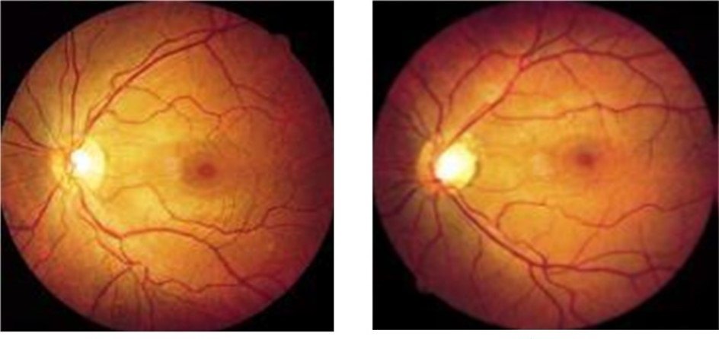
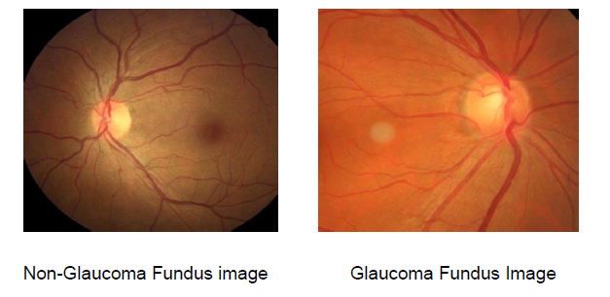
Images

Slide 7
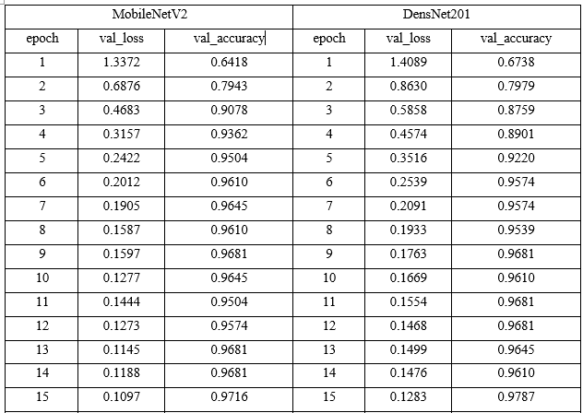
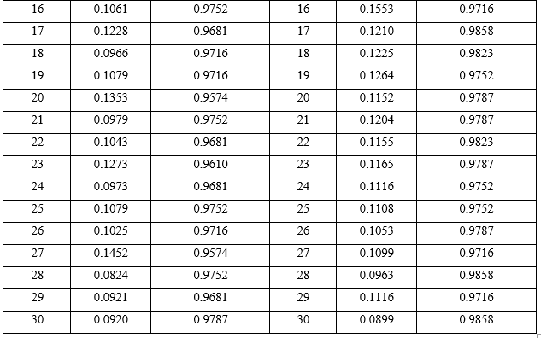
Model Testing
We have divided our dataset into the 70% for training and 30% for testing of the dataset, 30 epochs, and 30 batch sizes for training time.

Slide 8
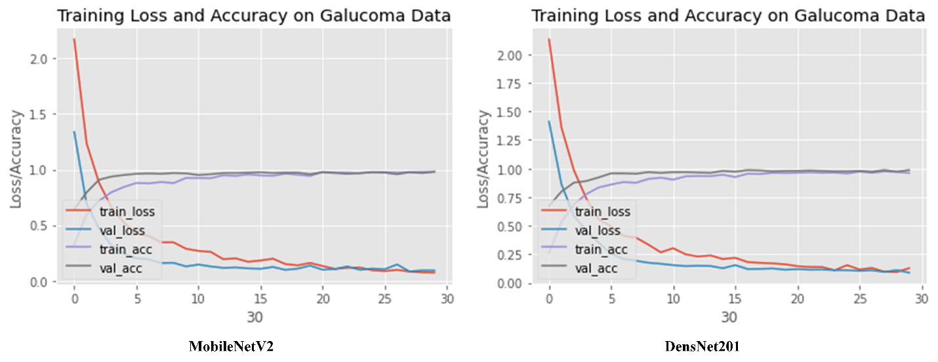
Accuracy

Slide 9
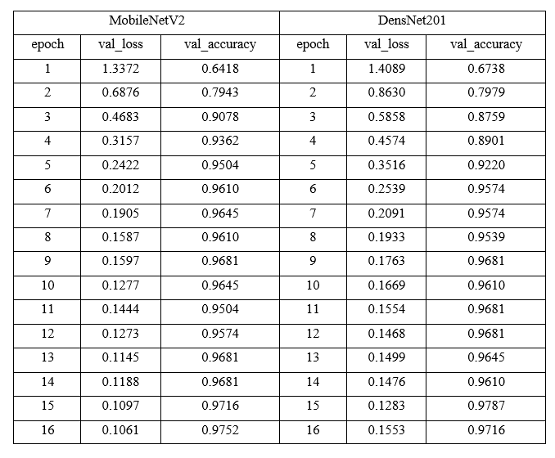
Accuracy

Slide 10
Conclusion
Proposed method mainly focuses on extracting the optic cup and disc from the fundus image precisely compared to other methods. It helps the doctors in confirming the presence of Glaucoma without the need for additional tests.
After we understand the CNN method and as the model is trained we received the accuracy of 90.58% accuracy.
This proposed method using a deep learning model trained on fundus images has the potential to improve the accuracy of glaucoma diagnoses. The model is trained on a dataset and can be used in small clinics and hospitals.

Slide 11
Future Works
The proposed method focuses on extracting the optic cup and disc from fundus images, which can help doctors confirm the presence of glaucoma without the need for additional tests.
Future work on the model may include incorporating additional risk factors, such as intraocular pressure and diabetes history, to improve its ability to screen for glaucoma
The stages of Glaucoma mean the level of progression of Glaucoma in every patient’s eye, which can help the doctors treat the patient accordingly and avoid unnecessary tests to detect the glaucoma progression
This way, it is economically friendly for patients and time-efficient for the doctors since no of people with Glaucoma is large.

Slide 12
Software Used
Google Colab
Tensorflow
Platform
Keras Library
Kaggle dataset
Pandas
Dataset
Library
SKlearn
Library

Slide 13
Thank
You

